Slide 1
ICO
Daniele Marazzina

Slide 2

Origins of the ICO
Willett explain a supplementary protocol to Bitcoin with built-in support for custom tokens (see Tether lecture): a protocol — called “MasterCoin” — that would leverage the existing Bitcoin blockchain by adding additional features and possibilities to it.
Obviously, Willet needed to fund his idea, so he asked for some BTC donations. In order to motivate potential investors, he also added that several features inside the protocol would only be available to those owning MasterCoins.
Willet introduced us the first ICO, and the first utility token
Total raised: US$600K
The MasterCoin protocol turned out to be incredibly successful. Rebranded to and known today as “Omni Layer” (#OMNI), it now serves as the underlying protocol for the Tether token (#USDT), which is the most traded crypto token after BTC itself.

Slide 3
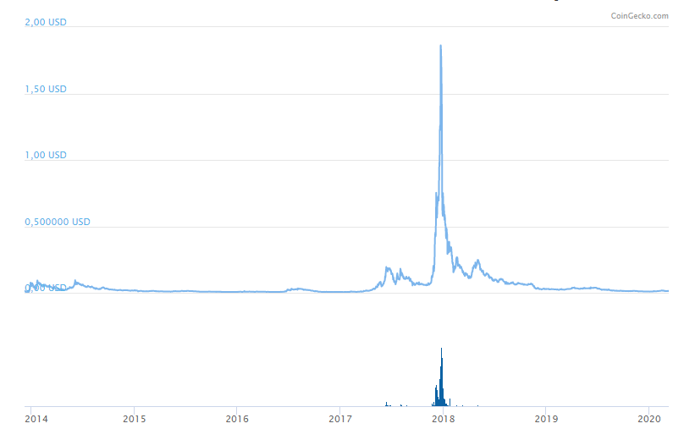
NextCoin (#NXT) is a peculiar second ICOs.
On 28 September 2013, the further anonymous Bitcointalk.org member BCNext created a forum thread announcing the proposed launch of “Nxt” as a second generation cryptocurrency.
He asked only for very small bitcoin donations in order to determine how to distribute the initial stake. A couple months later, on 18 November 2013, the fundraising for Nxt was closed, collecting 21 bitcoins

Slide 4
2014. Vitalik Buterin tries raising funds for a new and noteworthy ICO for what he envisions the world’s first zero-infrastructure platform, named “Ethereum”.
The token sale raised 3700BTC in the first 12 hours.
Total raised: US$18.3M
Since Ethereum’s inception, over 1,000 “ERC20” cryptocurrencies have been issued on the platform since its initial ICO. ERC20 itself is a protocol standard that defines certain rules and standards for issuing tokens on Ethereum’s network and infrastructure. ERC stands for Ethereum Request For Comments and 20 stands for a unique ID number to distinguish this standard from others.
In 2016 a decentralized autonomous organization called The DAO, a set of smart contracts developed on the platform, raised a record US$150 million in a crowd/token sale to fund the project. The DAO was exploited in June when US$50 million in Ether were taken by an unknown hacker (now that’s a heist!). Subsequently, Ethereum was split into two separate blockchains (a so-called “forking event”) — the new separate version became Ethereum (ETH) with the theft reversed, and the original continued as Ethereum Classic (ETC).
Solidity, initially proposed by Gavin Wood in August 2014, is the primary programming language (contract-oriented) used on the Ethereum platform.

Slide 5
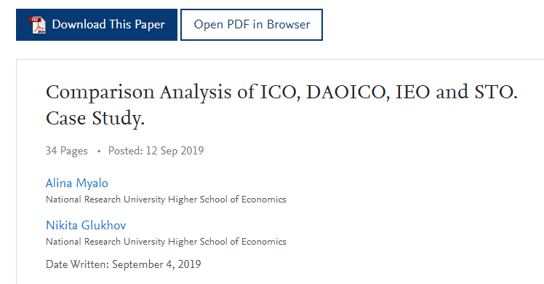
https://icomarks.com/
According to the ICORating, in the second half of 2018, the profitability of investments in blockchain startups decreased by 22%, and 58% of ICO projects announced in Q4 2018 were not able to raise more than 100,000 USD. Moreover, in Q4 2018 40% of projects with previously announced ICOs have already deleted their social network accounts and websites

Slide 6
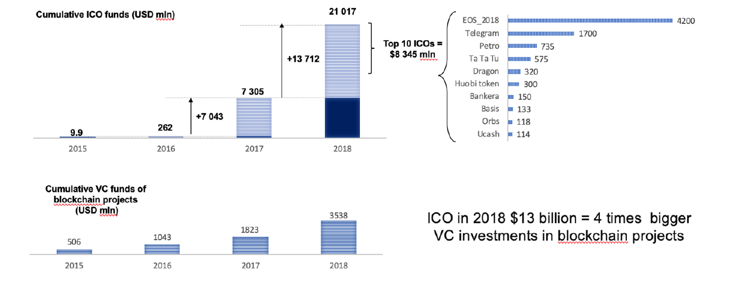
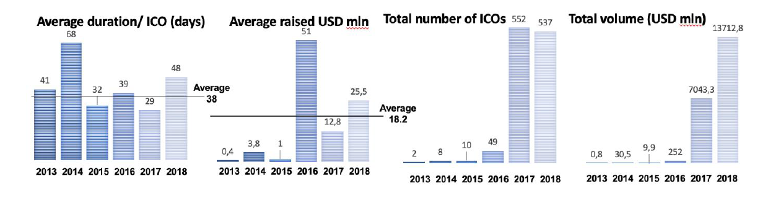

Slide 7
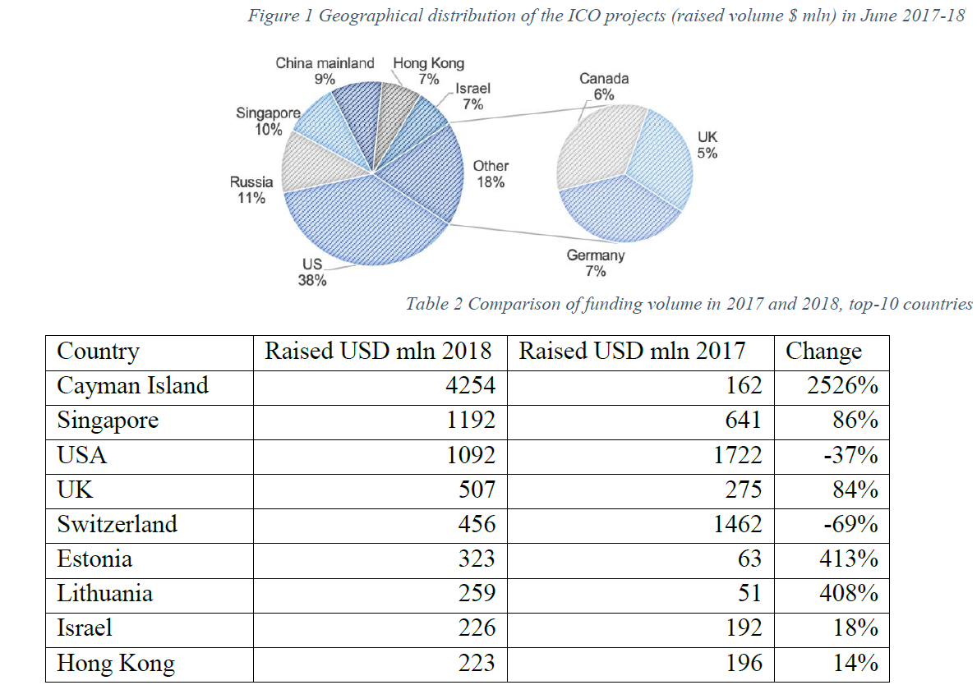

Slide 8
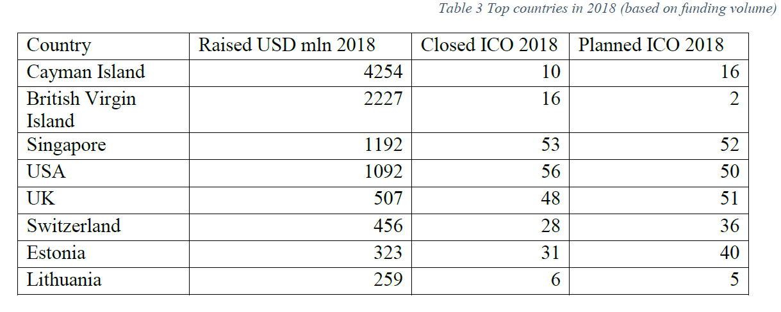
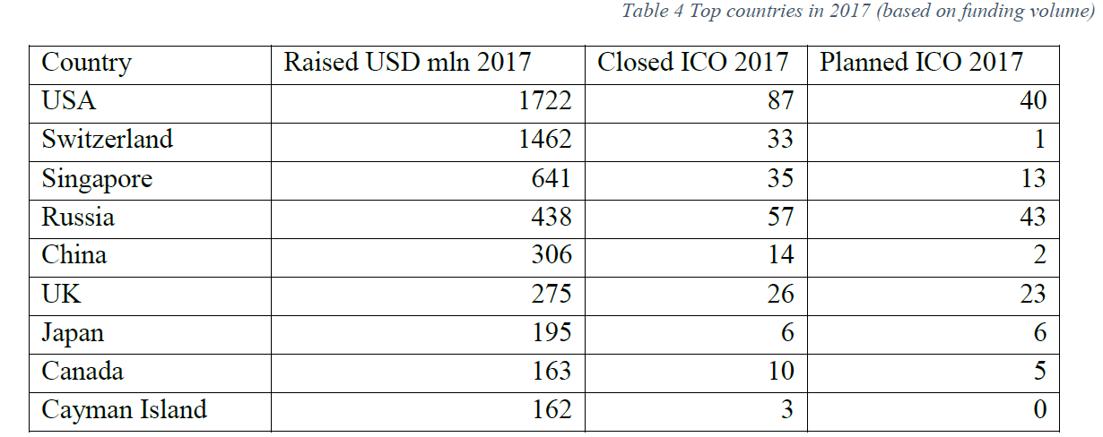

Slide 9
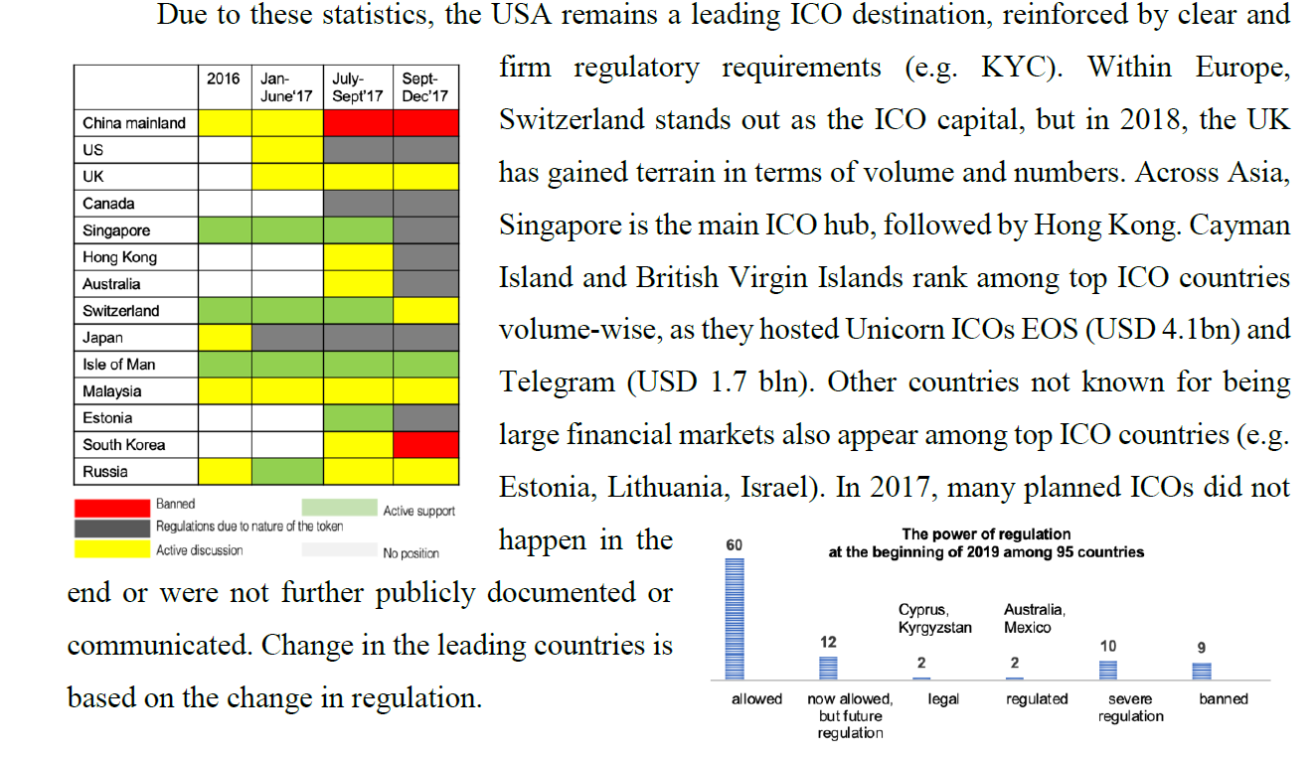

Slide 10
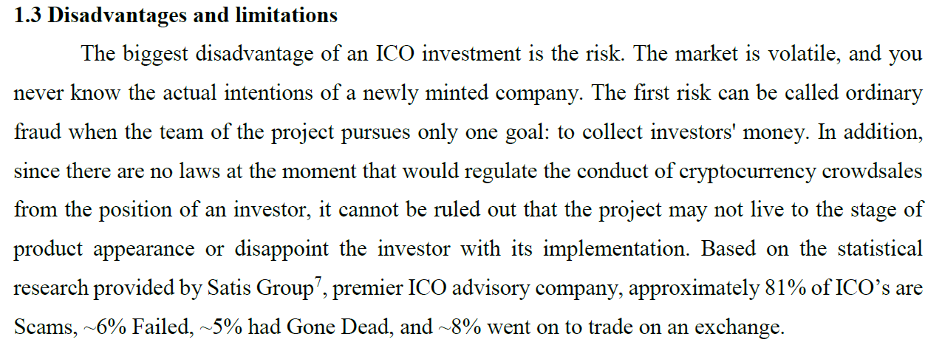
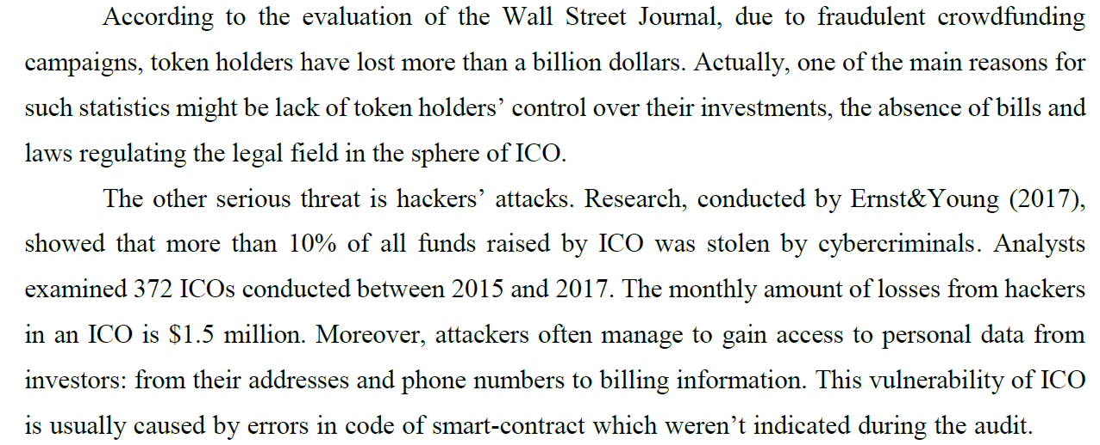

Slide 11
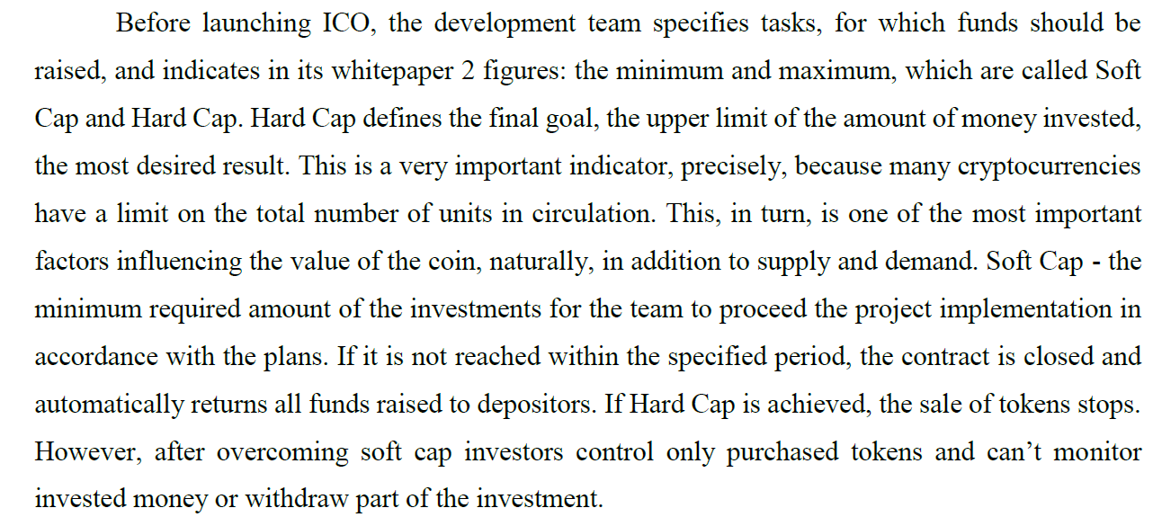

Slide 12
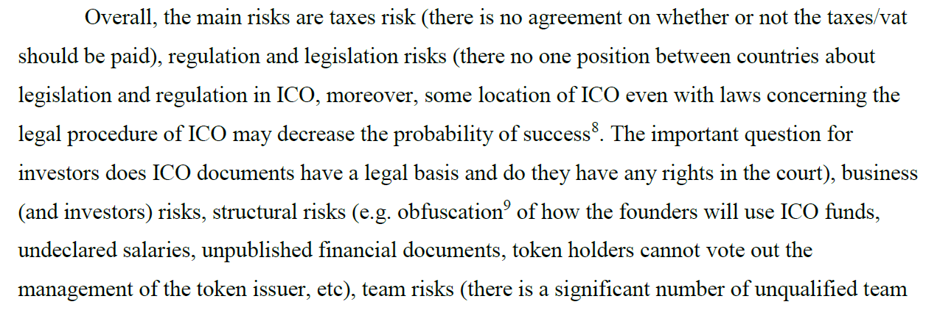
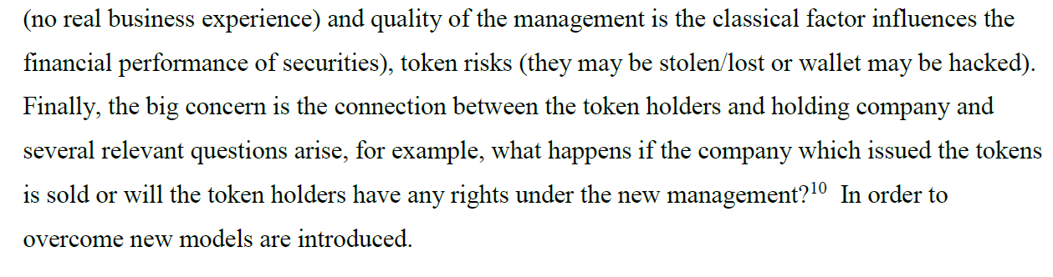

Slide 13
Decentralized Autonomous Initial Coin Offering (DAICO)
DAICO is a new fundraising model. Founder of Ethereum blockchain Vitalik Buterin proposed this model, combining the advantages of decentralized autonomous organizations (DAO) with the classic ICO. This synergistic model allows you to make the process of collecting and spending funds as transparent and safe as possible.
DAICO is based on a smart contract that regulates all actions to attract and work with funds.
The difference between DAICO and ICO begins after the first stage when a mechanism called a “tap” is launched. Tap allows tokens holders to control how much money is available to the team. The crane determines the amount per second that the development team can withdraw from the contract. Such tool gives to holders of tokens control over the spending of the funds raised and guaranteeing the security of their own investments. Payments to developers are made not once, but gradually, for example, once a month. If they need a larger amount than the one that is written in the smart contract, then this question is put to the vote. And holders of tokens can either approve this proposal or not.

Slide 14
Initial Exchange Offerings (IEO)
the cryptocurrency exchange is directly involved in the selection of projects, the organization of the tokensale and the sale of tokens
There are several advantages of IEO which are in overcoming the disadvantages of ICO:
1. The risk of Scams for investors is lower. The project is launched at the exchange after the serious procedure of verification. The exchange rejects the doubtful project in order to save its’ reputation.
2. The process of listing new tokens is faster.
3. Redistribution of costs becomes available. According to Autonomous Research, there is 1-3 mln cost to list the token at the exchange. An IEO project has lower costs for listing.
4. The speed of funding is higher. In ICO the primary distribution of tokens may been lasted for several days whereas in IEO it lasts several minutes or even seconds.
5. Investors’ gain is higher. The listing token values are bigger than in primary distribution.
6. There is no need to open another wallet.
7. The process of investing is simple, the investors need to replenish the balance on the exchange, wait for the token-sale and put an order for buying.
8. Tokens are traded at an equal price. This reduces the probability of falling rates from the early investors who purchased first.

Slide 15
At the same all these advantages have some drawbacks. For example, due to the high distribution speed, some investors have no time to make an order and buy tokens of big projects. Moreover, nowadays there is limited number of IEO, and they are not mainstream way of funding the projects. Reason for lower popularity is the unwillingness of exchanges to take additional work. The mentioned verification procedure is very strict, e.g. there is an obligation for verification of identity.
The good examples of successful projects are BitTorrent (BTT) (IEO took place on January 28, 2019, and raised more than $7.2 million in just 18 minutes).
https://icoholder.com/en/bittorrent-28385
According to the ICObench top of the countries conducting the IEO is the following: the first place is Singapore (11 projects, $58,8 mln), the second place is South Korea ( 8 projects with total number of funds equals to $31,8 mln) and the third place is Estonia (7 projects, $28,7 mln, but all funds are raised by one IEO - Windhan Energy). The rest important countries are the USA (6 projects, $25,8 mln), Hong Kong (4 projects, $65,7 mln – it is the leader by the total amount of funds raised), Cayman Islands (3 projects, $6,4 mln).

Slide 16
The biggest IEO that has ended until June 2019 is Bitfinex. This project is ranked 1st place by the total amounts raised during an IEO totaling $1billion. Bitfinex is the digital asset exchange, margin trading and funding platform, which includes Bitcoin, Ethereum, EOS, Litecoin, Ripple, NEO, Monero and many more cryptocurrencies in its circulation. The Bitfinex IEO started on the 5th of May and ended only 8 days later, however, at that small time issue of tokens called LEO attracted more than $100 million from each private company inside and outside the industry and more than $1 million from each user, even though it was conducted only on a private basis. The firm never got it to the stage of the public sale. It was founded by a HongKong firm called iFinex Inc, however, launched in the British Virgin Islands. The project has a white paper and it accepts cryptocurrency called USDT or Tether.
In June 2019 there are 188 people employed in Bitfinex according to LinkedIn, while on Twitter it has 501 thousand of subscribers. From this case, the evident advantage of IEO over an ICO is the presence of existing user base on the exchange platform that allows to raise tremendous investments even on the private sale stage.

Slide 17
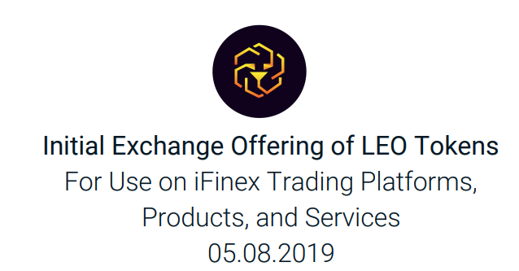
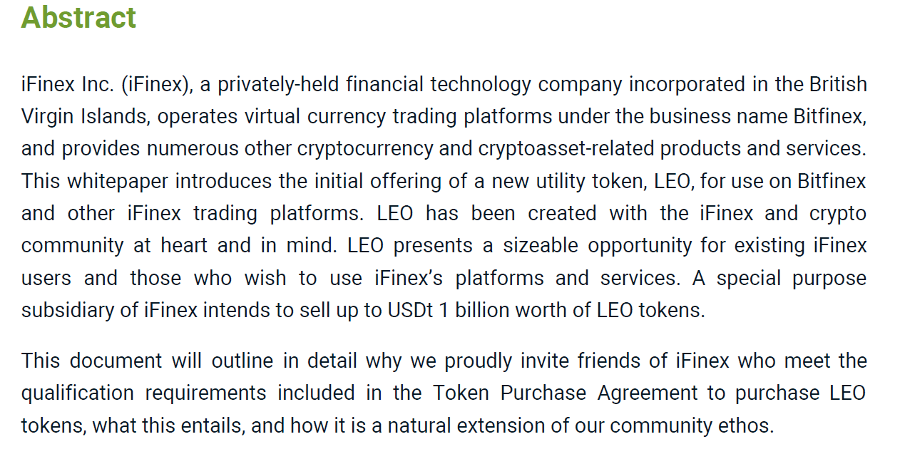

Slide 18
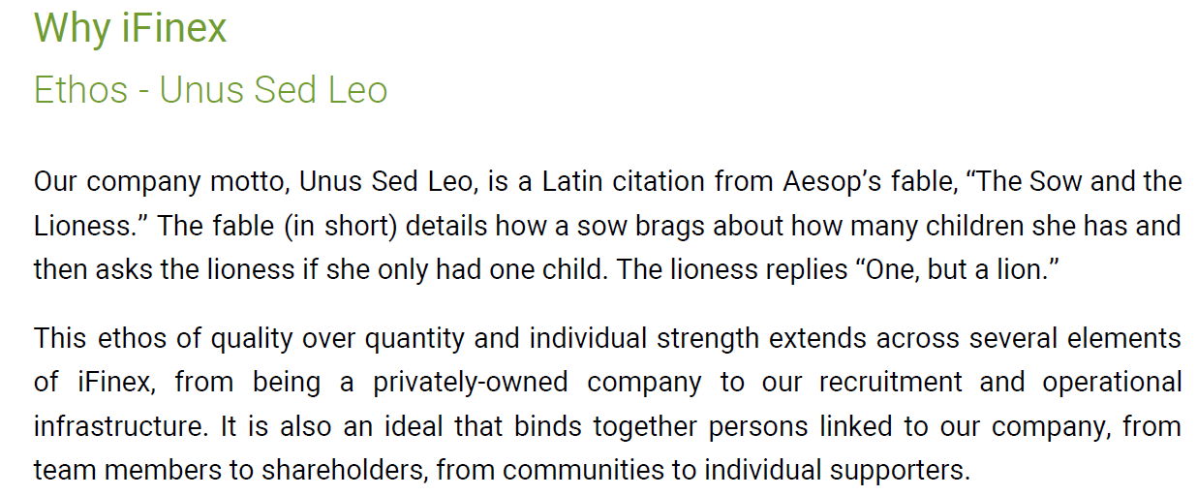
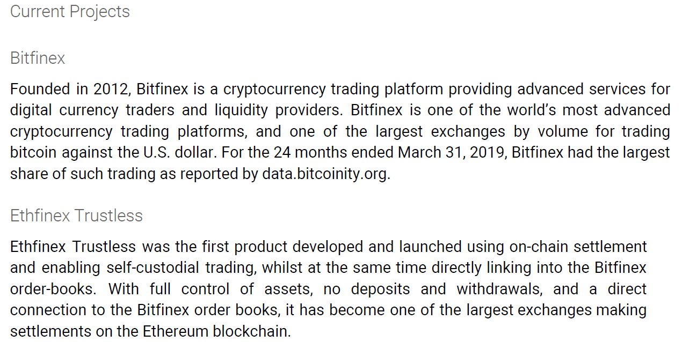

Slide 19
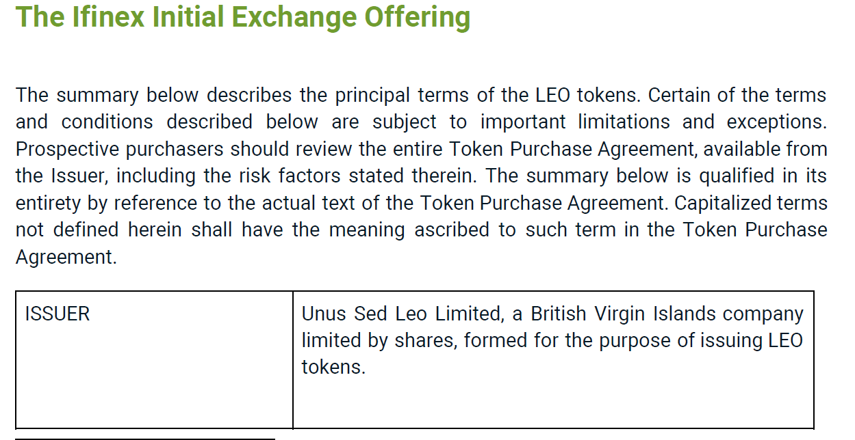
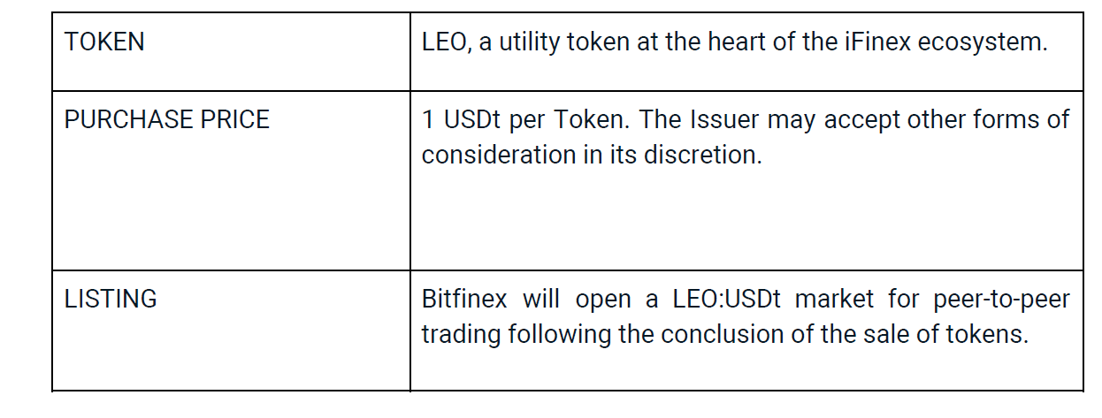

Slide 20
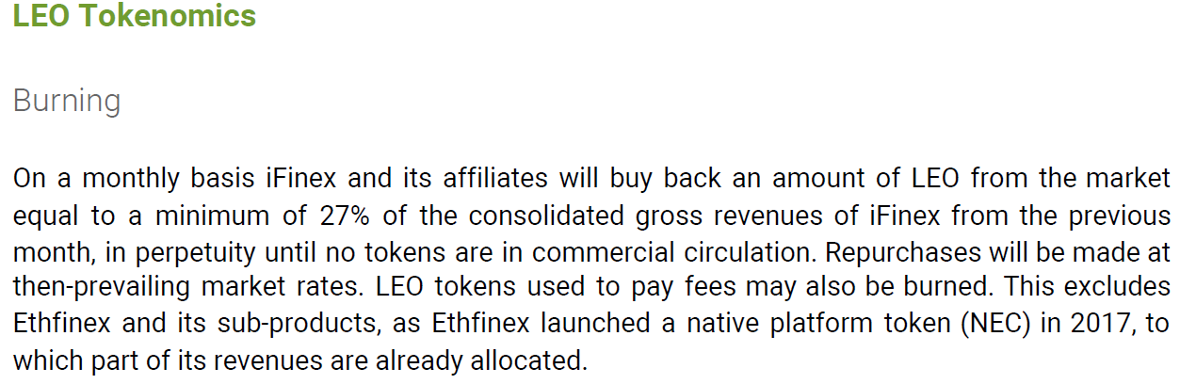
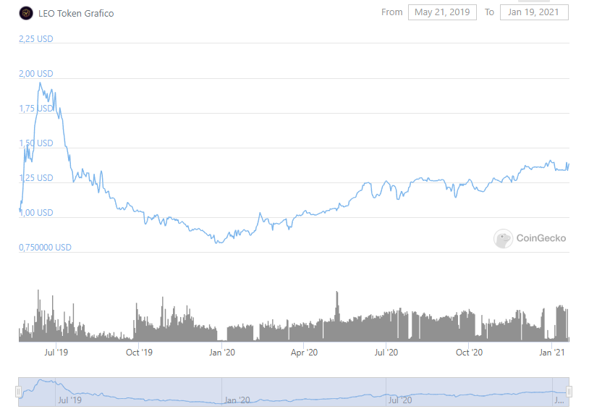

Slide 21
Security Token Offerings (STO)
The popular utility tokens used in ICO have the main disadvantage, which is the absence of any compensation for investors in case of ICO fail as utility tokens are not security papers leading to the absence of any obligations for making beneficial conditions for investors.
The decision to this challenge is security token. Security tokens represent real capital in the enterprise, at the same time such token is not necessarily tied to a share in the company, it can be used to divide the rights of the ownership. In fact, they may give the holder a number of rights: ownership of shares, periodic dividends, cashflows, payment of debts, the right to vote, etc. All these rights are secured by a smart contract. Due to the features of these tokens, their value is supported by securities, therefore, they are considered an investment.
The issue of security tokens requires serious supervision by regulatory authorities. This supervision leads to the protection of investments and gives investors more rights, thus restoring the balance of power from the point of view of stakeholders
Security token offering (STO) is the initial offer of security tokens. STO is similar to ICO in one thing: both issues token for investors. The main reason for buying securities token is dividends or voting rights .
STO project meets all the requirements of the SEC means that investor's money is protected by law. In case of disputes, the investor can file a complaint with the appropriate authority since this type of token falls under the legislation on securities

Slide 22
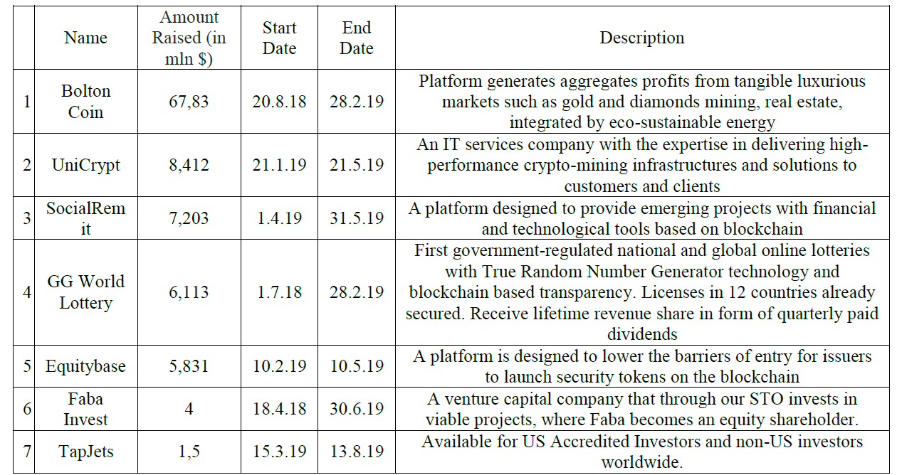
By 20th March 2019, 122 STOs have already been completed, raising $512M.
54 Security Token Offerings are currently listed and ongoing.
Out of 328 STOs launched so far, only 12 of them have failed (3.65%). STO raised $1258 mln in overall.

Slide 23
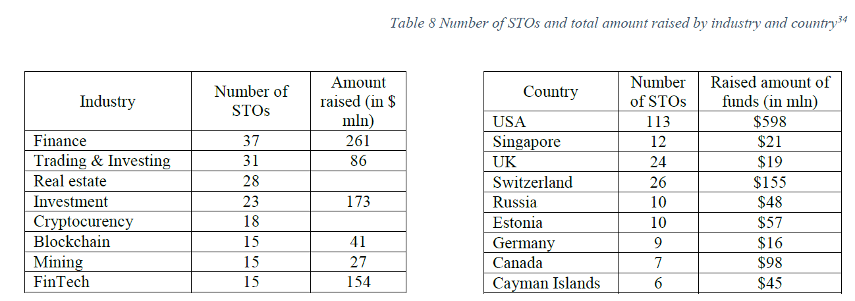

Slide 24
